Slide 1
ANN
Name | {Replace this with your name}
Identity Key | {Replace this with your identity key}
 | Level | Completed
 | Beginner | 0
 | Intermediate | 0
 | Advanced | 0
 | Expert | 0
Goal
4722 | 14
5722 | 16
Total Completed
0

Slide 2
Artificial Neural Network (ANN)
CSCI 5722/4722: Computer Vision
Spring 2024
Dr. Tom Yeh
Dr. Mehdi Moghari

Slide 3
Graphical Representation

Slide 4
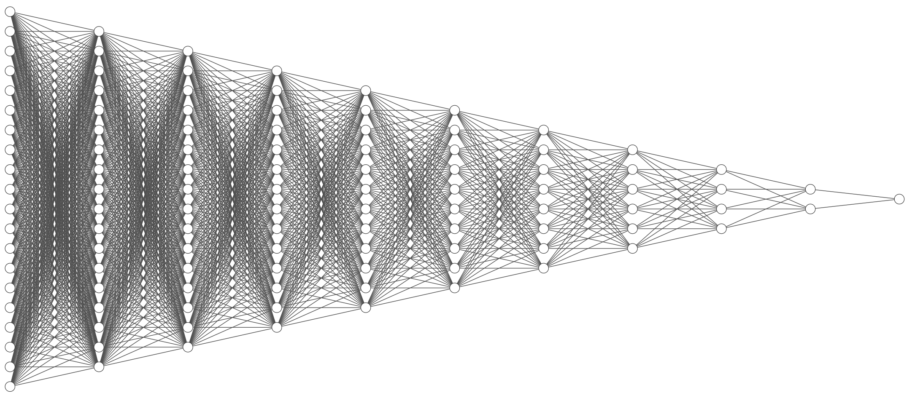
Image Generated by: http://alexlenail.me/NN-SVG

Slide 5
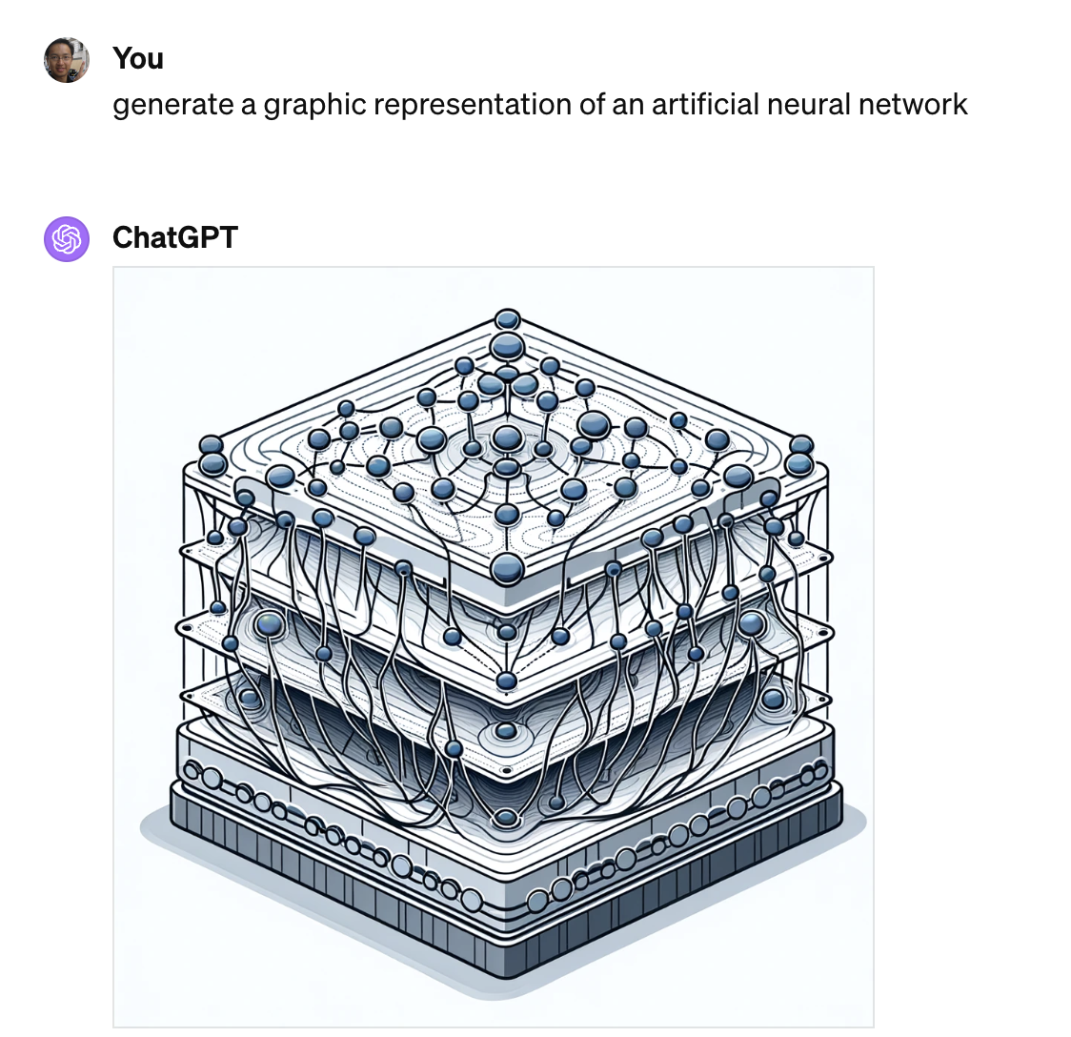
ChatGPT
Here is a graphic representation of an artificial neural network. This illustration shows the typical structure with an input layer, multiple hidden layers, and an output layer, all connected by lines representing the connections between neurons. Each layer is composed of circles symbolizing neurons. The input, hidden, and output layers are appropriately labeled for clarity.

Slide 6
Prompt ChatGPT to draw an ANN, as complex or absurd as possible
{Enter your prompt Here}
{Paste the image here}

Slide 7
2 Layer Network

Slide 9

Layer 1, Node 1
$$×$$
1 | 0 | 1
-2

Slide 10
Layer 1, Node 2
2
4
$$×$$
-1
1 | 1 | 0
-3

Slide 11

Layer 2, Node 1
0
3
1
0
x | σ(x)
-5 | ~0
-4 | 0.02
-3 | 0.05
-2 | 0.12
-1 | 0.27
0 | 0.5
1 | 0.73
2 | 0.88
3 | 0.95
4 | 0.98
5 | ~1
$$×$$
1 | 0 | 1 | 0
-3

Slide 12
Matrix Representation

Slide 13
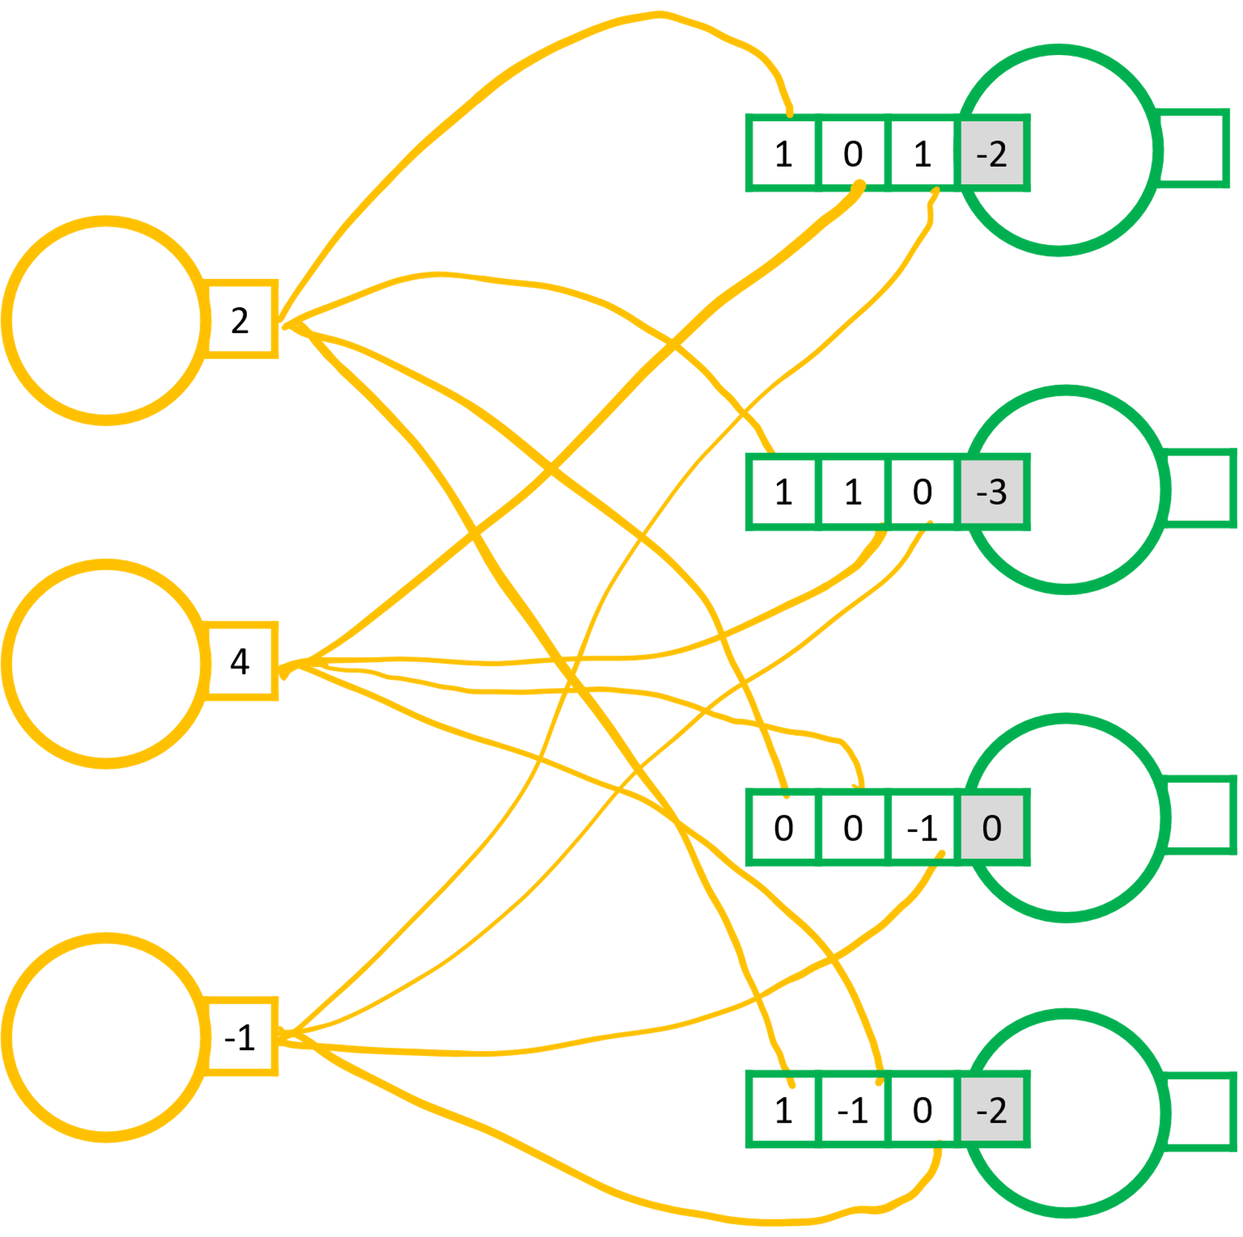
Graph → Matrices [Layer 1]
ReLU

Slide 14
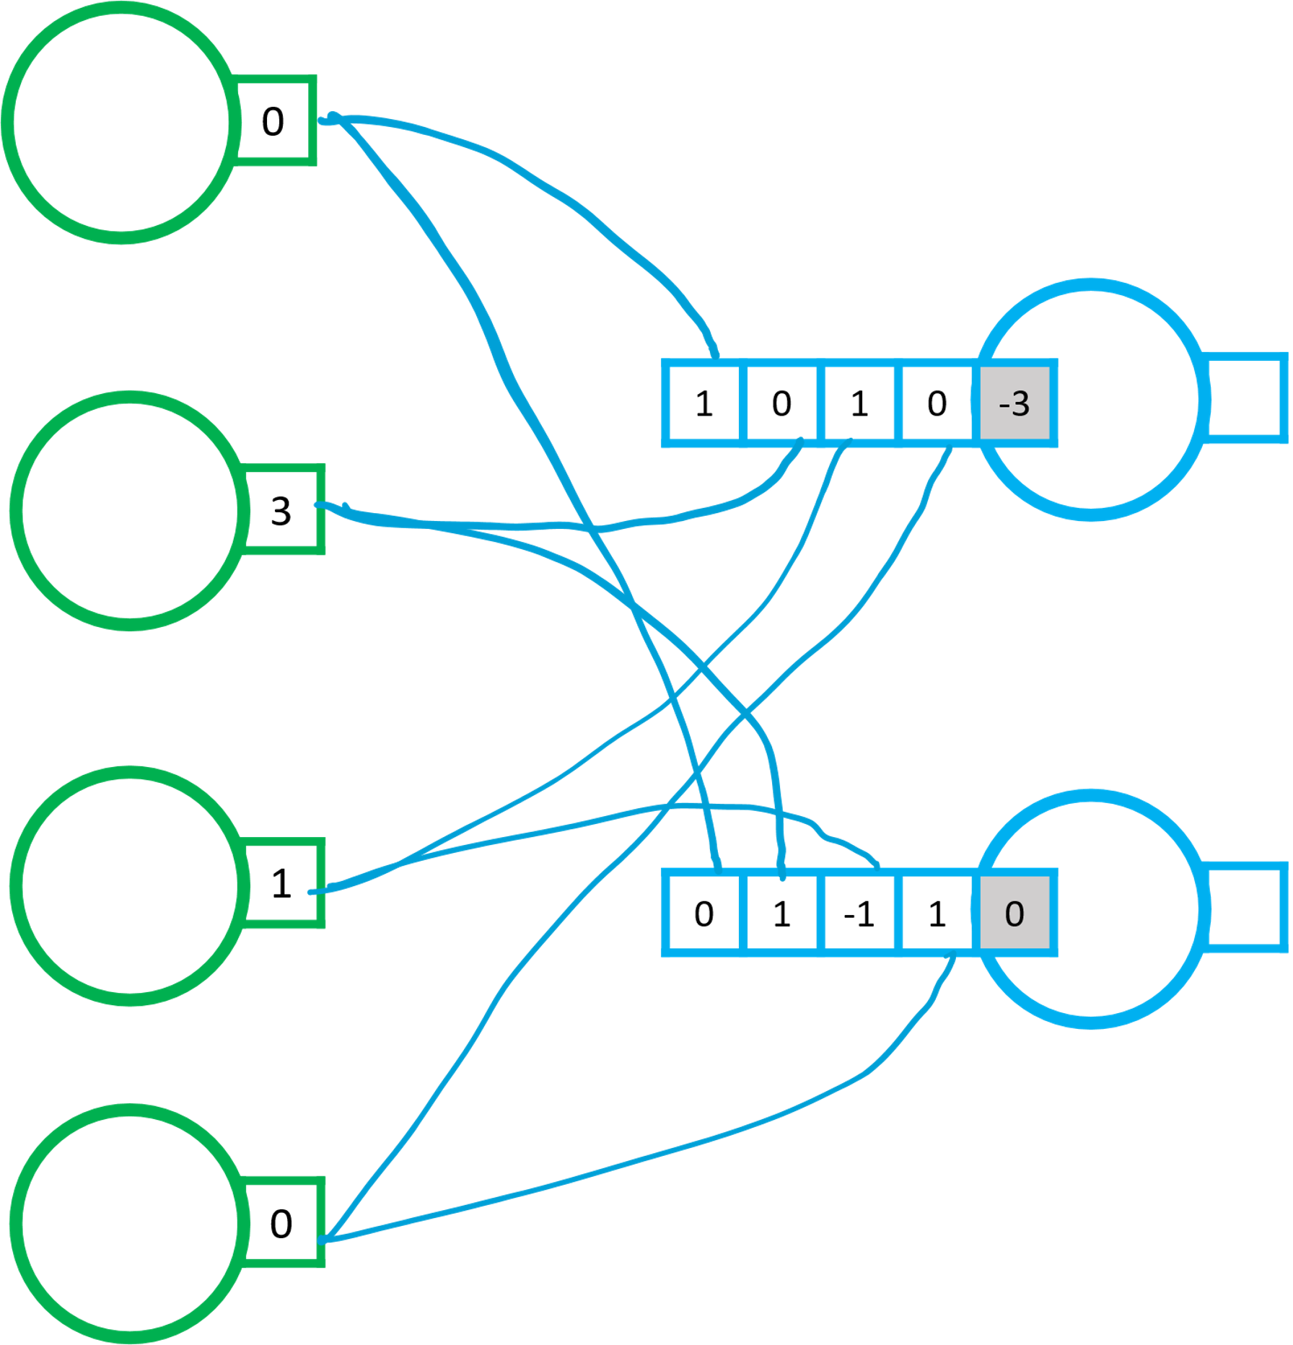
Graph → Matrices [Layer 2]
x | σ(x)
-5 | ~0
-4 | 0.02
-3 | 0.05
-2 | 0.12
-1 | 0.27
0 | 0.5
1 | 0.73
2 | 0.88
3 | 0.95
4 | 0.98
5 | ~1
0
3
1
0
ReLU≈

Slide 15
Calculate ReLU
1
-1
3
-4
2
-1
5
0
a
ReLU
b
≈
c
d
e
f
g
h
🔑 a+b+c+d=4; e+f+g+h=7

Slide 16
Calculate a Linear Layer + ReLU
1
2
-3
1
1 | 0 | 1 | -2
1 | 1 | 0 | -2
0 | 0 | -1 | 0
1 | -1 | 0 | 0
a
ReLU
b
≈
c
d
🔑 a+b+c+d=4

Slide 17
Calculate a Linear Layer + ReLU
1
2
5
3
4
1
1 | 0 | 1 | 0 | 0 | -3
0 | 1 | 0 | 1 | 0 | -4
0 | 0 | 1 | 0 | 1 | -5
1 | 0 | 0 | 0 | 1 | -6
a
ReLU
b
≈
c
d
🔑 a+b+c+d=8

Slide 18
Find smallest bias terms to activate (integers)
1
2
-3
1
1 | 0 | 1
1 | 1 | 0
0 | 0 | -1
1 | -1 | 0
a
1
1
1
1
1
1
1
1
b
ReLU
≈
c
d
🔑 a+b+c+d=1

Slide 19
Softmax

Slide 20
Logits → Probability Distribution
0
3
1
0
1 | 0 | 1 | 0 | -3
0 | 1 | -1 | 1 | 0
0 | 1 | 0 | -1 | -2
-2
2
0
σ
≈
.12
.88
.5
-2
2
0

Slide 21
Calculate Softmax by hand (e ≈ 3) ✍️
-4
2
0

Slide 22
Output Probability Distribution
Logits
e□ (e ≈ 3)
0
0
0
0
1
0
0
0
1/Σ
Σ

Slide 23
Calculate Softmax
Output Probability Distribution
Logits
e□ (e ≈ 3)
0
0
0
0
0
0
0
0
1
1
1
1
1
1
1
1
a
1/Σ
Σ
8
🔑 a*1000 % 13 = 8

Slide 24
Calculate Softmax
Output Probability Distribution
Logits
e□ (e ≈ 3)
0
2
0
0
1
0
0
1
1
9
1
1
3
1
1
3
a
b
c
1/Σ
Σ
20
🔑 a+b+c =0.65

Slide 25
Calculate Softmax
Output Probability Distribution
Logits
e□ (e ≈ 3)
-2
-1
-1
-2
-2
-5
-5
-5
1/9
1/3
1/3
1/9
1/9
0
0
0
a
round to 0.00
b
c
1/Σ
Σ
1
🔑 a+b+c=0.44

Slide 26
Multi Layer Perceptron (MLP)

Slide 27
Matrices → Graphic [2 layers]
2
4
-1
1
1 | 0 | 1 | -2
1 | 1 | 0 | -3
0 | 0 | -1 | 0
1 | -1 | 0 | 0
-1
3
1
-2
ReLU
≈
0
3
1
0
1
1 | 0 | 1 | 0 | -3
0 | 1 | -1 | 1 | 0
0 | 1 | 0 | -1 | -2
-2
2
0
σ
≈
.12
.88
.5

Slide 28
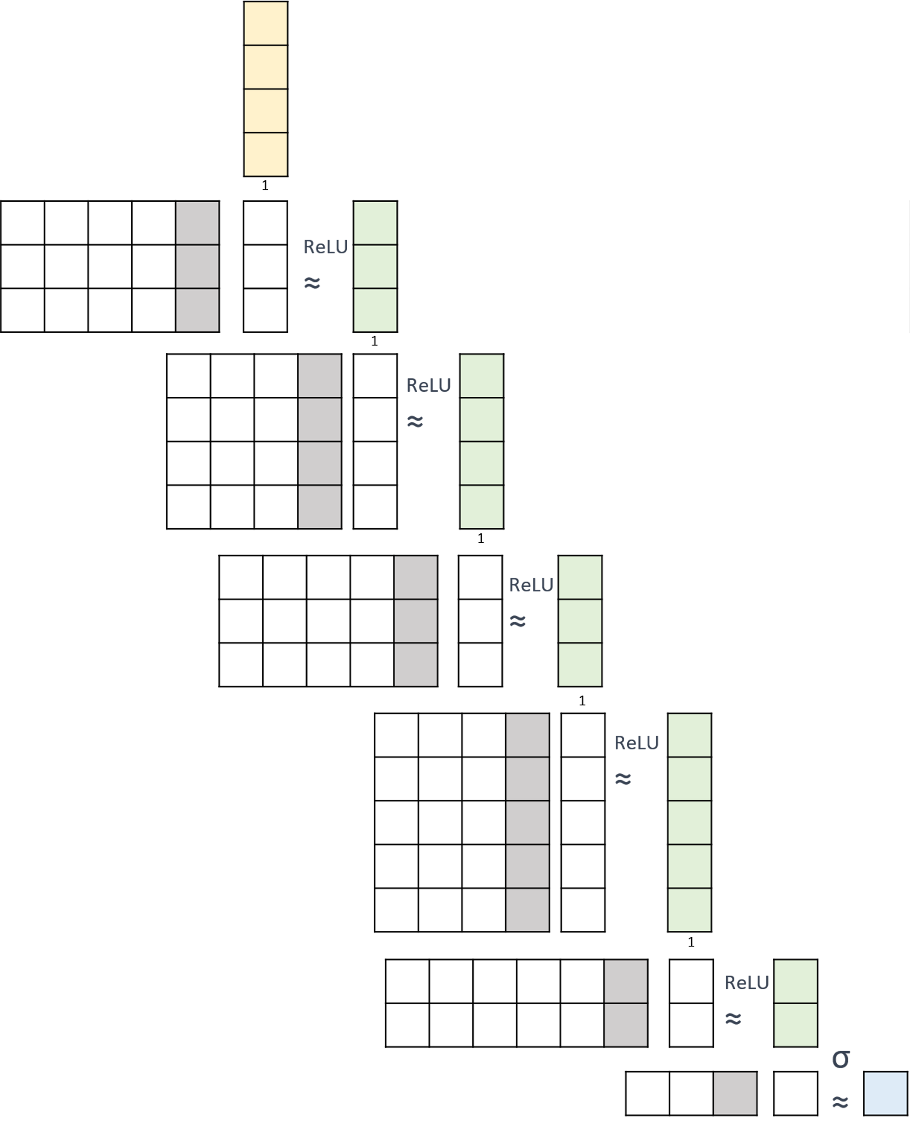
Matrices → Graphic [6 layers]

Slide 29
Calculate an MLP
2
1
3
-1
Calculate the last feature / node / row only.
1
1 | 1 | 0 | 0 | 0
1
2
ReLU
≈
1
1 | -1 | 1 | -1
ReLU
≈
3
2
0
1
0 | 1 | -1 | 1 | -1
ReLU
≈
2
1

Slide 30
Calculate an MLP
2
1
3
-1
Calculate the second feature / node / row only.
1
1 | 0 | 1 | 1 | 0
ReLU
≈
1
3
a
1
1 | 1 | -1 | 1
ReLU
≈
1
5
2
b
1
0 | 1 | -1 | 0 | -2
ReLU
≈
3
1
c
🔑 a+b+c=7

Slide 31
Add a hidden node (green)
Δcount W1: ________; b1: _________
1
+
ReLU
≈
Δcount W2: ________; b2: _________
1
ReLU
≈

Slide 32
Remove a hidden node (green)
1
Δcount W1: ________; b1: _________
ReLU
≈
Δcount W2: ________; b2: _________
1
ReLU
≈

Slide 33
Insert a layer
Δcount W1: ________; b1: _________
1
+
Δcount W2: ________; b2: _________
ReLU
≈

Slide 34
Add two hidden nodes (green)
(Add rows or columns to show your work)
Δcount W1: ________; b1: _________
1
+
W1
b1
ReLU
≈
Δcount W2: ________; b2: _________
W2
b2
1
ReLU
≈

Slide 35

Add one input node & remove one output node
+
(Add rows or columns to show your work)
Δcount W1: ________; b1: _________
1
W1
b1
ReLU
≈
Δcount W2: ________; b2: _________
W2
b2
1
ReLU
≈

Slide 36
Batch / Mini-Batch

Slide 37
Batch
1 | -2 | 1 | -2 | 0 | -2 | 1 | 2 | -1 | 0 | 2 | -1
2 | 6 | -1 | 4 | 1 | 0 | 4 | 1 | -2 | 2 | 0 | 3
0 | 1 | 5 | 0 | 4 | 0 | -1 | 0 | 3 | 0 | -1 | 0
1 | 1 | 1 | 1 | 1 | 1 | 1 | 1 | 1 | 1 | 1 | 1
1 | 0 | 1 | -2
1 | 1 | 0 | -2
0 | 0 | -1 | 0
1 | -1 | 0 | 0

Slide 38
Mini Batch
1 | -2 | 1 | -2 | 0 | -2 | 1 | 2 | -1 | 0 | 2 | -1
2 | 6 | -1 | 4 | 1 | 0 | 4 | 1 | -2 | 2 | 0 | 3
0 | 1 | 5 | 0 | 4 | 0 | -1 | 0 | 3 | 0 | -1 | 0
1 | 1 | 1 | 1 | 1 | 1 | 1 | 1 | 1 | 1 | 1 | 1
1 | 0 | 1 | -2
1 | 1 | 0 | -2
0 | 0 | -1 | 0
1 | -1 | 0 | 0

Slide 39

2 Layers
1 | -2 | 1 | -2 | 0 | -2 | 1 | 2 | -1 | 0 | 2 | -1
2 | 6 | -1 | 4 | 1 | 0 | 4 | 1 | -2 | 2 | 0 | 3
0 | 1 | 5 | 0 | 4 | 0 | -1 | 0 | 3 | 0 | -1 | 0
Mini-batch size = 2
Calculate 2nd batch
ReLU:
1 | 1 | 1 | 1 | 1 | 1 | 1 | 1 | 1 | 1 | 1 | 1
1 | 0 | 1 | -2
1 | 1 | 0 | -2
0 | 0 | -1 | 0
1 | -1 | 0 | 0
1 | 1 | 1 | 1 | 1 | 1 | 1 | 1 | 1 | 1 | 1 | 1
1 | 1 | 1 | 1 | 0
1 | 0 | 0 | -1 | 2

Slide 40
2 Layers
1 | -2 | 1 | -2 | 0 | -2 | 1 | 2 | -1 | 0 | 2 | -1
2 | 6 | -1 | 4 | 1 | 0 | 4 | 1 | -2 | 2 | 0 | 3
0 | 1 | 5 | 0 | 4 | 0 | -1 | 0 | 3 | 0 | -1 | 0
Mini-batch size = 2
Calculate 4th batch
ReLU:
1 | 1 | 1 | 1 | 1 | 1 | 1 | 1 | 1 | 1 | 1 | 1
1 | 0 | 1 | -2
1 | 1 | 0 | -2
0 | 0 | -1 | 0
1 | -1 | 0 | 0
1 | 1 | 1 | 1 | 1 | 1 | 1 | 1 | 1 | 1 | 1 | 1
1 | 1 | 1 | 1 | 0
1 | 0 | 0 | -1 | 2
a
c
b
d
🔑 a+b=6; c+d=3

Slide 41
Cross Entropy Loss

Slide 42
Softmax for a mini batch
1 | 1 | 1 | 1 | 1
-6 | -6 | 2 | -8 | -6
-5 | 2 | 0 | 2 | 2
0 | -8 | -6 | -7 | 0
2 | 0 | -7 | -6 | -7

Slide 43
Predictions vs. Targets
🐷 | 🐶 | 🐷 | 😺 | 🐮
0 | 0 | .9 | 0 | 0
0 | .9 | .1 | 1 | .9
.1 | 0 | 0 | 0 | .1
.9 | .1 | 0 | 0 | 0

Slide 44
High vs. Low Loss
🐷 | 🐶 | 🐷 | 😺 | 🐮
dog
cat
cow
pig
0 | 0 | .9 | 0 | 0
0 | .9 | .1 | 1 | .9
.1 | 0 | 0 | 0 | .1
.9 | .1 | 0 | 0 | 0
Is loss high, medium, low?
dog
cat
cow
pig
 | 1
 |  |  | 1
 |  |  |  | 1
1 |  | 1

Slide 45
Calculate CE Loss
🐷 | 🐶 | 🐷 | 😺 | 🐮
-log(0) ≈
-log(0.1) ≈
-log(0.9) ≈
-log(1) =
dog
cat
cow
pig
 | 1
 |  |  | 1
 |  |  |  | 1
1 |  | 1
dog
cat
cow
pig
0 | 0 | .9 | 0 | 0
0 | .9 | .1 | 1 | .9
.1 | 0 | 0 | 0 | .1
.9 | .1 | 0 | 0 | 0

Slide 46

Calculate CE Loss
😺 | 🐮 | 🐷 | 🐷
P₁ | P₂ | P₃ | P₄
Q₁ | Q₂ | Q₃ | Q₄
-log(0) ≈32
-log(0.1) ≈ 3
-log(0.9) ≈ 0.2
-log(1) = 0
cat
cow
pig
1
 | 1
 |  | 1 | 1
cat
cow
pig
.9 | 0 | .1 | .1
.1 | .1 | .9 | 0
0 | .9 | 0 | .9
cat | cow | pig
P₁
P₂
P₃
P₄
1
 | 1
 |  | 1
 |  | 1
a
b
c
d
🔑 a+b+c+d=35.4

Slide 47
Calculate CE Loss
😺 | 🐮 | 🐷 | 🐷 | 🐶
P₁ | P₂ | P₃ | P₄ | P₅
Q₁ | Q₂ | Q₃ | Q₄ | Q₅
-log(0) ≈32
-log(0.1) ≈ 3
-log(0.9) ≈ 0.2
-log(1) = 0
dog
cat
cow
pig
dog
cat
cow
pig
0 | 0 | .9 | .1 | 1
0 | .9 | .1 | .9 | 0
.1 | .1 | 0 | 0 | 0
.9 | 0 | 0 | 0 | 0
dog | cat | cow | pig
P₁
P₂
P₃
P₄
P₅
a
b
c
🔑 a+b+c+d+e=99
d
e

Slide 48
NumPy by Hand ✍️ [Perceptron]

Slide 49
ReLU
z
2
-1
1
p = z > 0
a = np.zeros((3,1))
a[p] = z[p]

Slide 50
Perceptron
W
1 | 1 | 0
0 | -1 | 1
1
-2
2
0
1
Wb = np.__stack((W,___))
xh = np.__stack((W,___))
z = np.matmul(Wb, Xh)
p = x ___ 0
a = np.zeros((___,1))
a[p] = z[p]
b
x

Slide 51
Add a node
Show your work below
W
1 | 0 | 1
0 | 1 | -1
1
-1
2
0
1
1 | 1 | 0
2
Wb = np.hstack((W,b))
xh = np.vstack((W,[___]))
r = np.__stack((w3,[b3]))
Wb = np.__stack((Wb,r))
z = np.matmul(Wb, Xh)
p = x > 0
a = np.zeros((3,1))
a[p] = z[p]
a
b
b
c
x
d
e
f
a
w3
b3
🔑 a+d+e+f=9

Slide 52

Pytorch by Hand ✍️ [MLP]

Slide 53
pytorch ← Matrix
2
1
3
-1
mlp_model = nn.Sequential(
nn.___________( ___, ___, bias = ___ ),
nn.__________(),
nn.__________( ___, ___, bias = ___ ),
nn.__________(),
nn.__________( ___, ___, bias = ___ ),
nn.__________(),
)
1
1
2
3
ReLU
≈
1
ReLU
≈
3
2
0
1
1
σ
≈
2
1
2

Slide 54
pytorch ← Matrix
mlp_model = nn.Sequential(
nn.Linear( ___, ___, bias = ___ ),
nn.ReLU(),
nn.Linear( ___, ___, bias = ___ ),
nn.ReLU(),
nn.Linear( ___, ___, bias = ___ ),
nn.Sigmoid(),
)
a
b
c
1
ReLU
≈
d
e
f
1
ReLU
≈
g
h
i
σ
≈
🔑 a+d+g=12; b+e+h=11

Slide 55
Fill in the missing arguments
mlp_model = nn.Sequential(
nn.Linear(128, 64),
nn.ReLU(),
nn.Linear( ______, ______ ),
nn.ReLU(),
nn.Linear(512, 32),
nn.Sigmoid(),
)
a
b
🔑 a+b=576

Slide 56

Visualize Pytorch Models Torchview
X

Slide 57
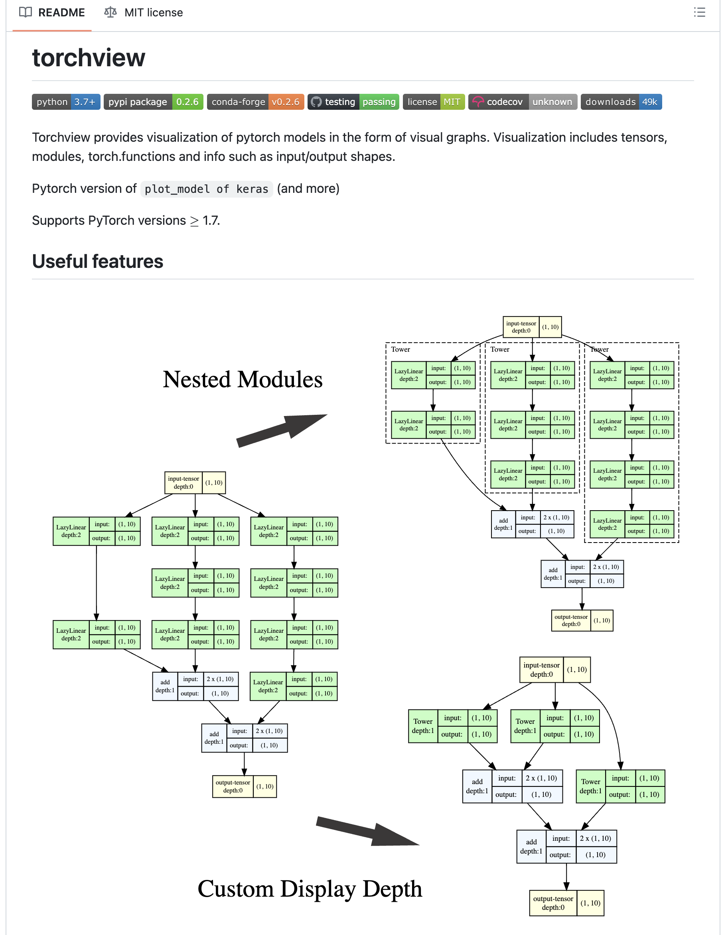
https://github.com/mert-kurttutan/torchview
Introduction Notebook
[Click to Open]

Slide 58
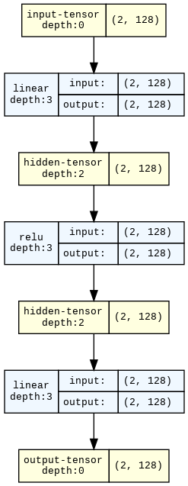
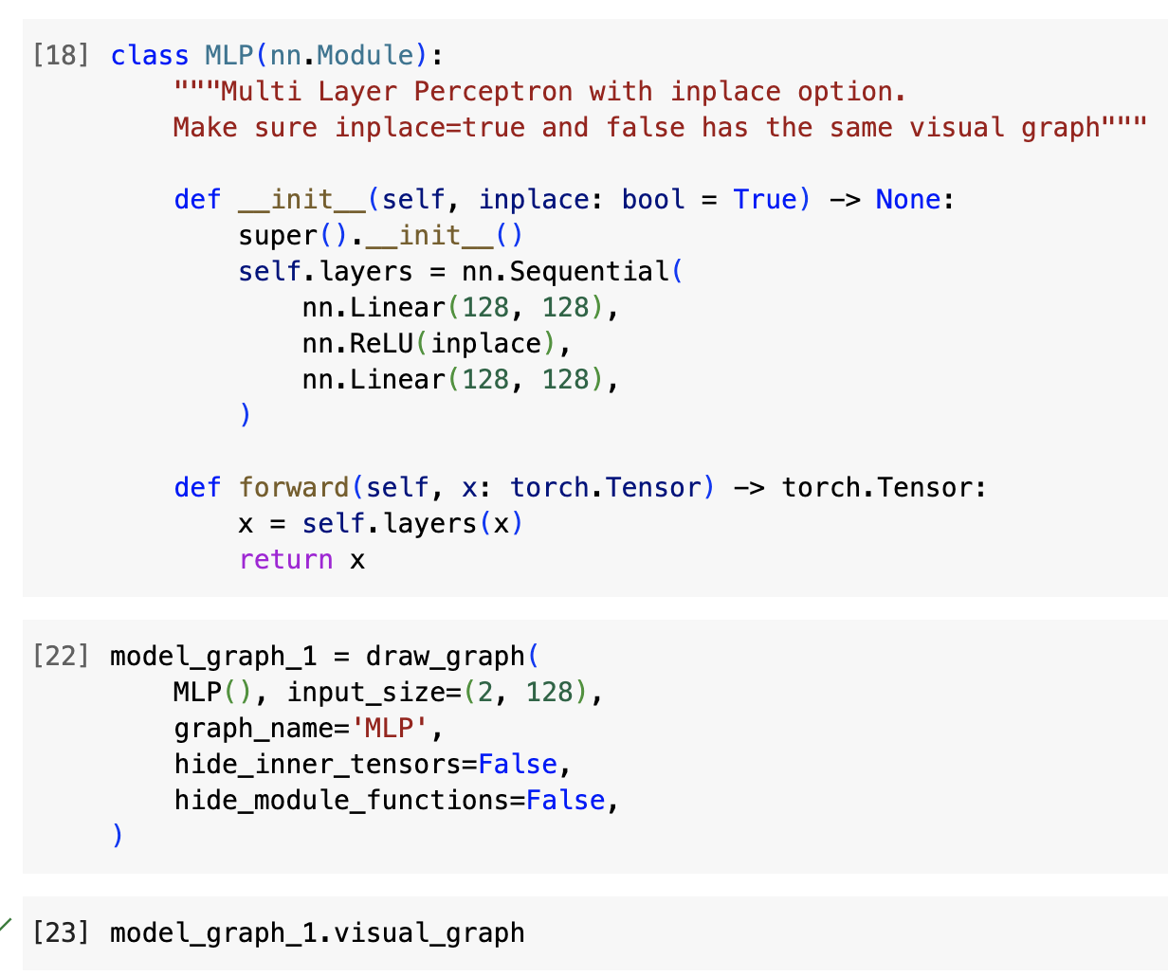
Introduction Notebook
[Link to Colab]

Slide 59
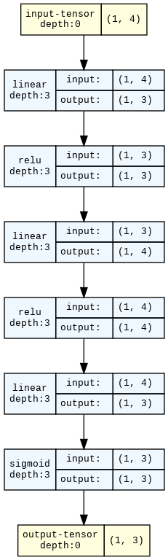
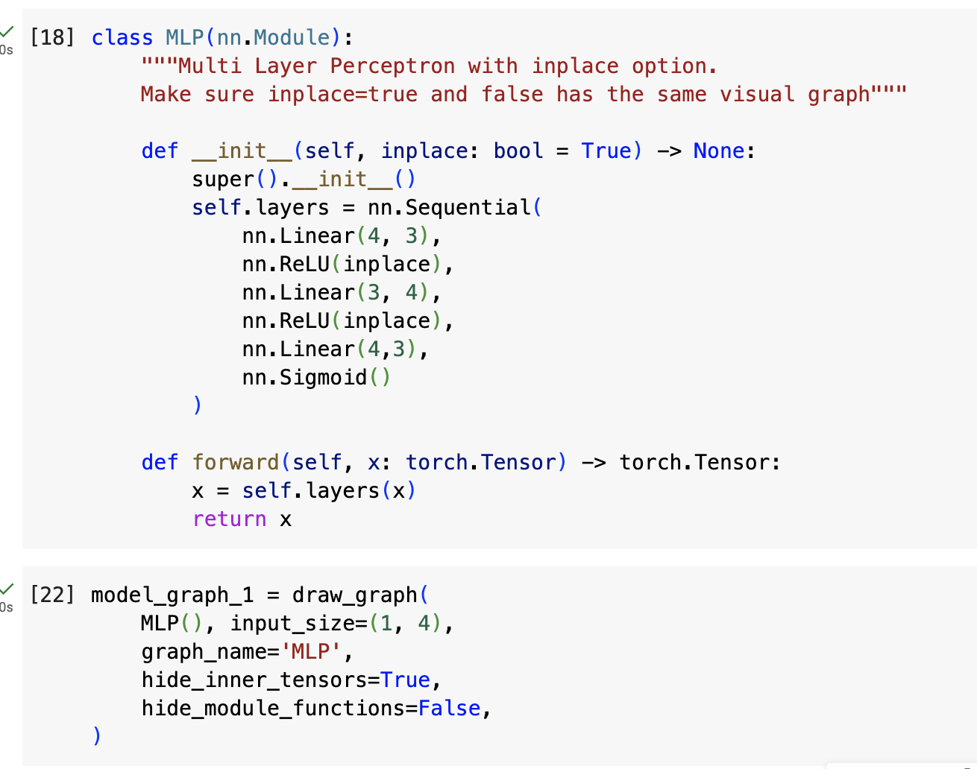

Slide 60
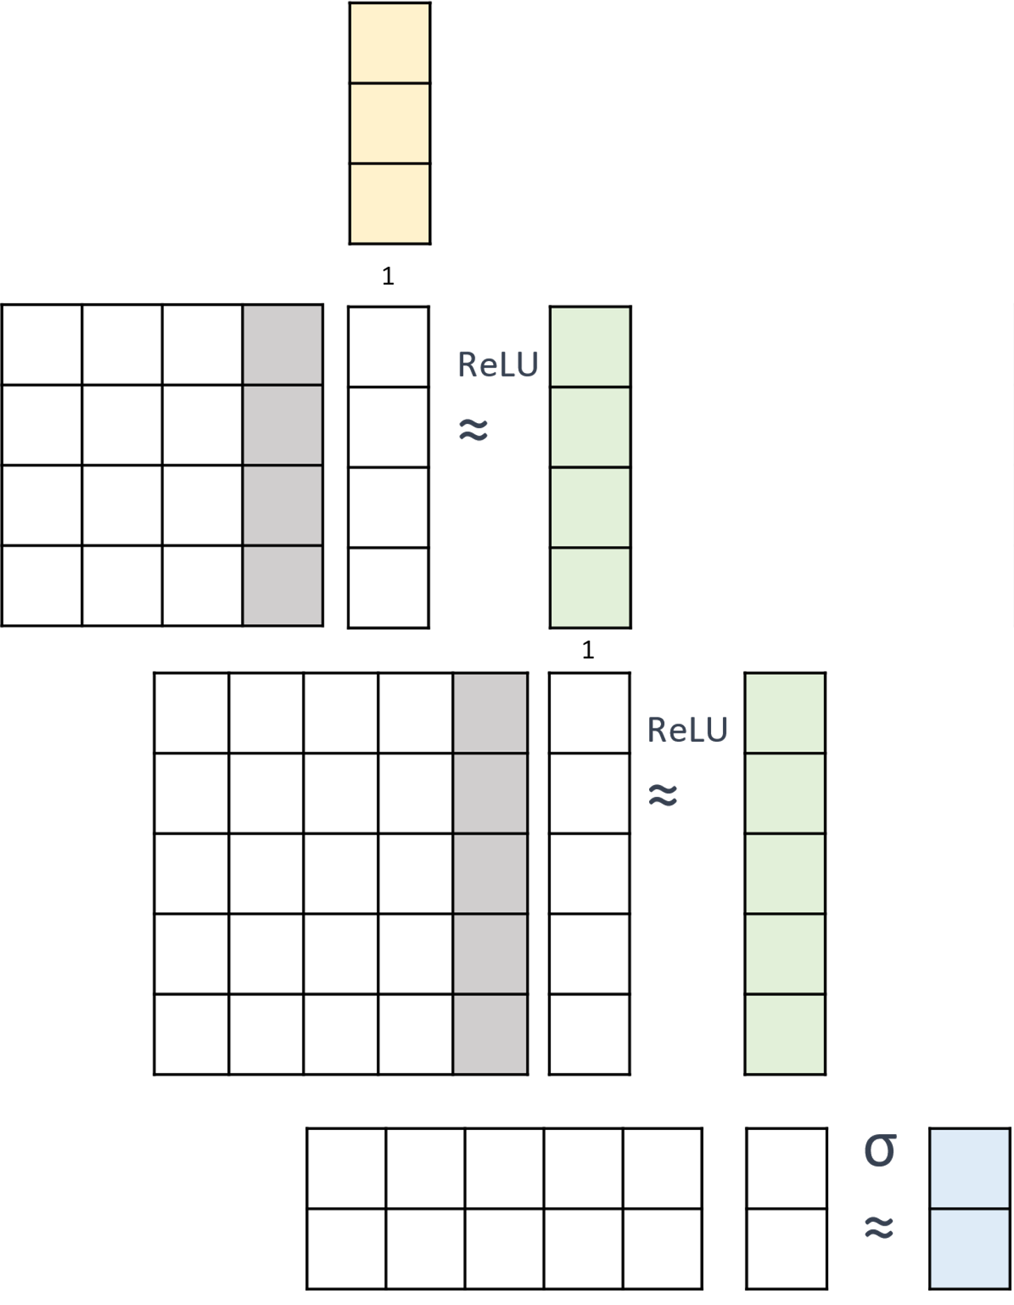
Use Torchview to generative an MLP graph
Modify the example notebook [Link to Colab]
{replace this placeholder with the graph you generated}

